Slide 1
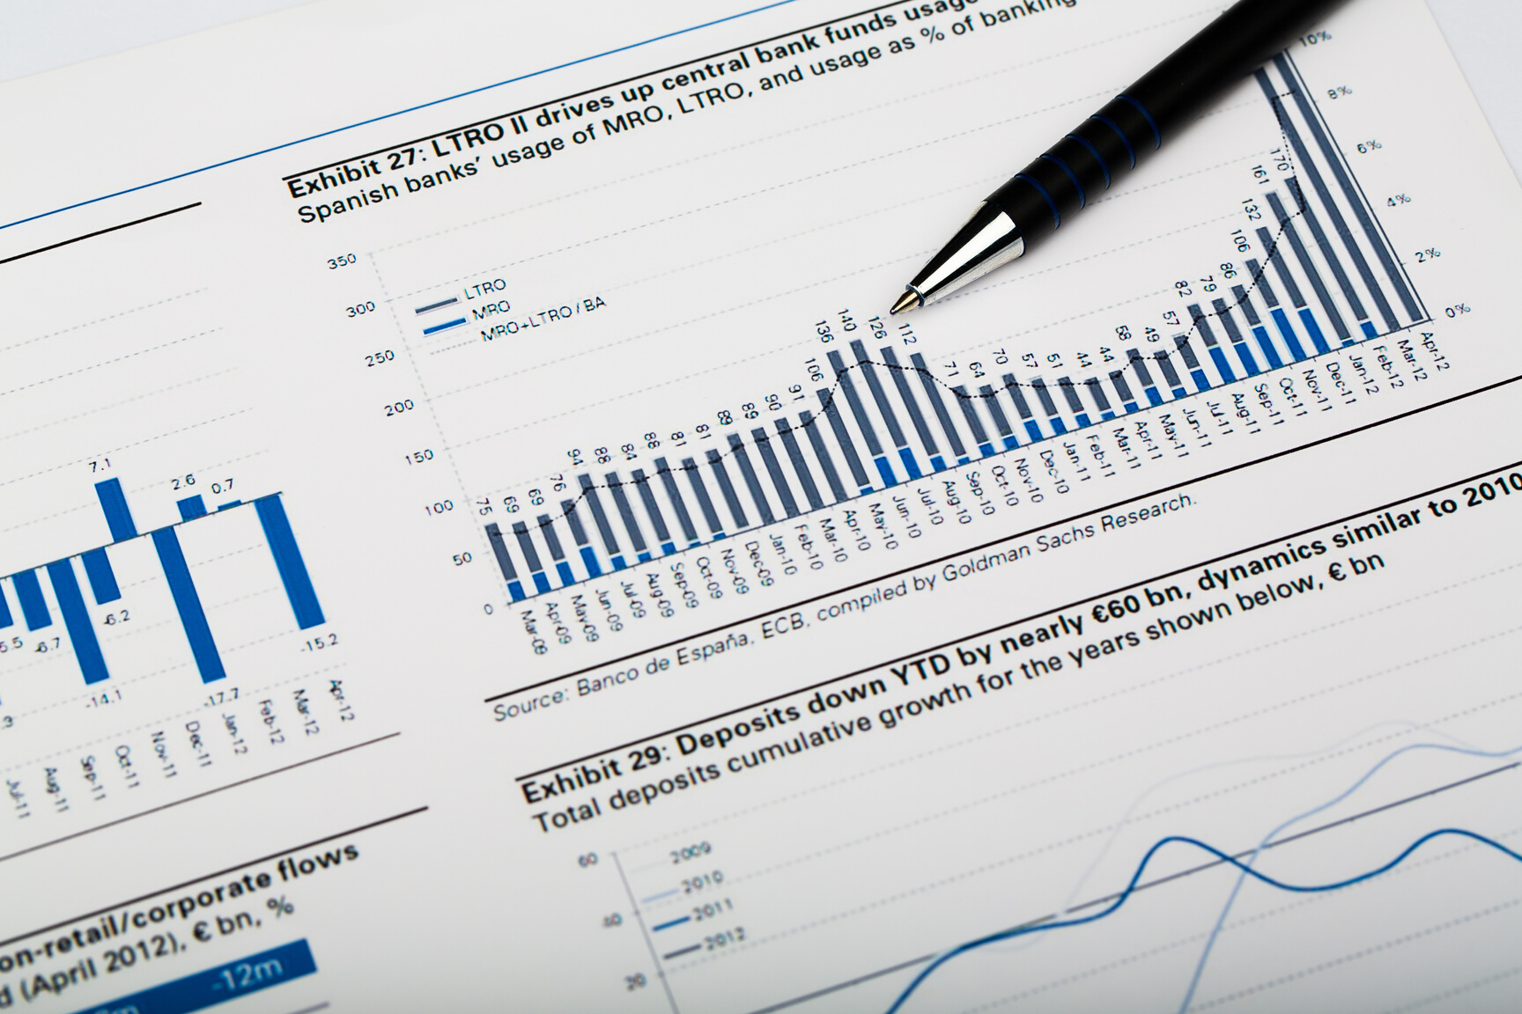
CSCI 5408 - Data Mgmt Warhsng Analytics
Case Study
Data Warehouse
/01
Group 29
Moni Shah - B00830791
Itekela Satyakumar – B00839907
Parth Parmar - B00853913

Slide 2

Agenda
Case Study - Data Warehouse
Data Warehouse
Data Transforming & Cleaning
Building Data Warehouse
Designing Schema
Cognos BI
Reports
/02

Slide 3
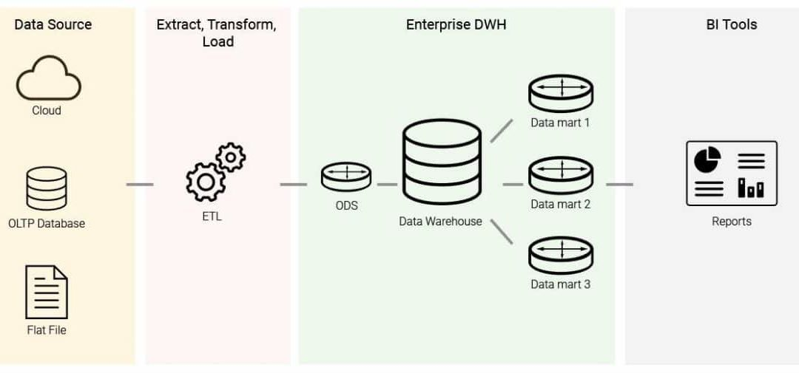
Data Warehouse
A Data Warehousing (DW) is process for collecting and managing data from varied sources to provide meaningful business insights.
/03
Case Study - Data Warehouse

Slide 4
For this case study we have explored the “Sample sales Data” of Kaggle owned by Gus Segura.
This dataset conveys information like an actual sales data of a company and is inspired for retails analytics.
There are total 25 columns in this dataset and most of them are self explanatory.
Gathering and Transforming Data
/04
Case Study - Data Warehouse

Slide 5
Data cleaning is important because it improves your data quality and in doing so, increases overall productivity.
Importance of data cleaning includes better business decisions followed by better analysis and presentation.
Incorrect data leads to false decisions or conclusion.
Also, all the cleaning was done keeping in mind the data integrity should be maintained.
Data Cleaning
/05
Case Study - Data Warehouse

Slide 6
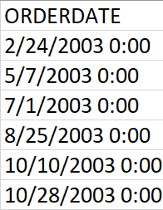
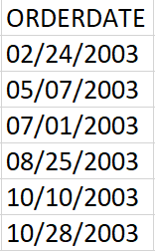
Case Study - Data Warehouse
Data Cleaning
Formatted the ORDERDATE column – MM/DD/YYYY
/06

Slide 7
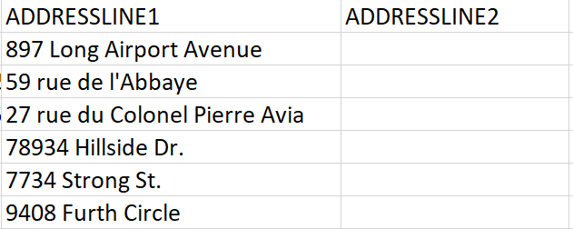
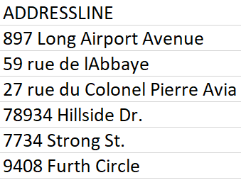
Case Study - Data Warehouse
Data Cleaning
Cleaned the ADDRESSLINE1 column and merged ADDRESSLINE1 & ADDRESSLINE2 - ADDRESSLINE
/07

Slide 8
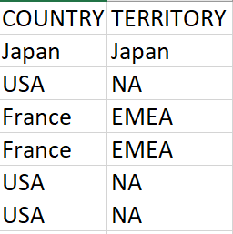
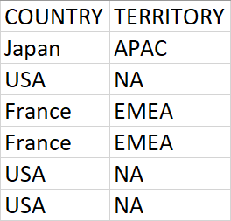
Case Study - Data Warehouse
Data Cleaning
Updated Japan territory – APAC from Japan
Also considered cleaning Phone Number and Contact Last Name
/08

Slide 9
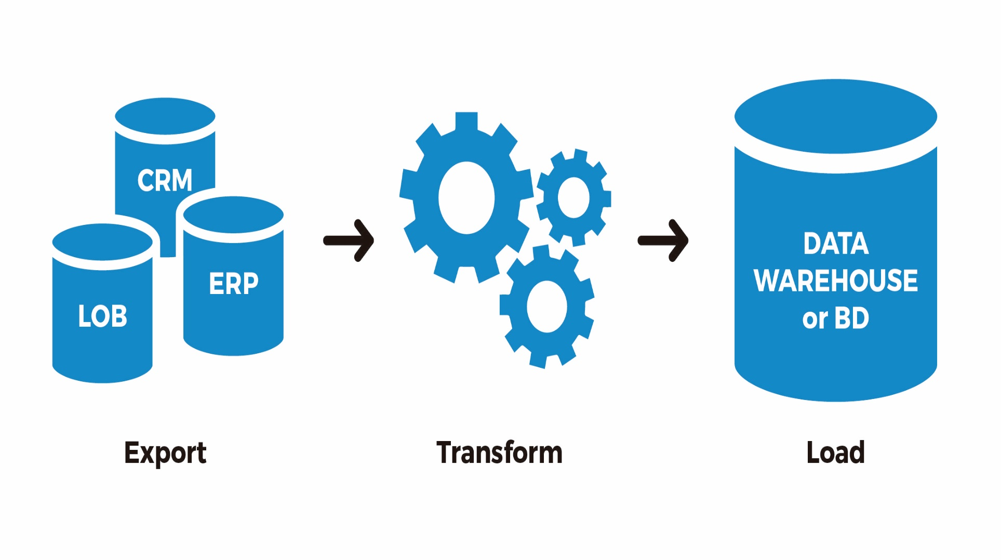
Case Study - Data Warehouse
Extract, Transform & Load
ETL has three functions that are combined into one tool to pull data out of one database and place it into another database.
Data Extraction – Data Identification and Analysis
Data Transform – Cleaning, Formatting and Transformation of data
Data Load - Loading transformed data into the database or data Warehouse.
Building Data Warehouse
/09

Slide 10
Case Study - Data Warehouse
Building Data Warehouse
Dimensional Modelling
A design concept which uses facts and dimensions
/10

Slide 11
FACT
Order??
Sales
Tables
Dimensions
Customer
Location
Product
Time
Case Study - Data Warehouse
/11

Slide 12
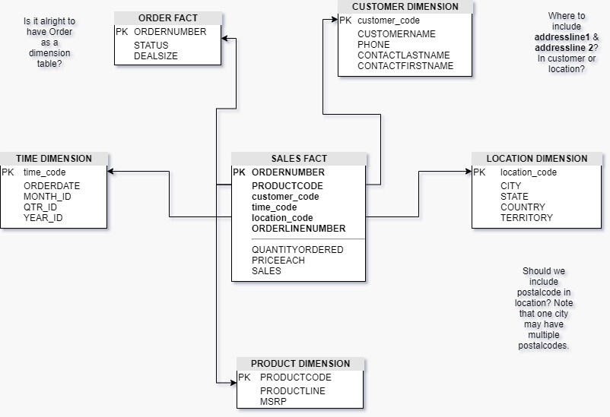
Case Study - Data Warehouse
Initial Star Schema
/12

Slide 13
Normalized dimension tables
Reduction in disk space
Fewer risks of data corruption
Better integration with reporting tools
Logically organized
Snowflake
Schema
Case Study - Data Warehouse
/13

Slide 14
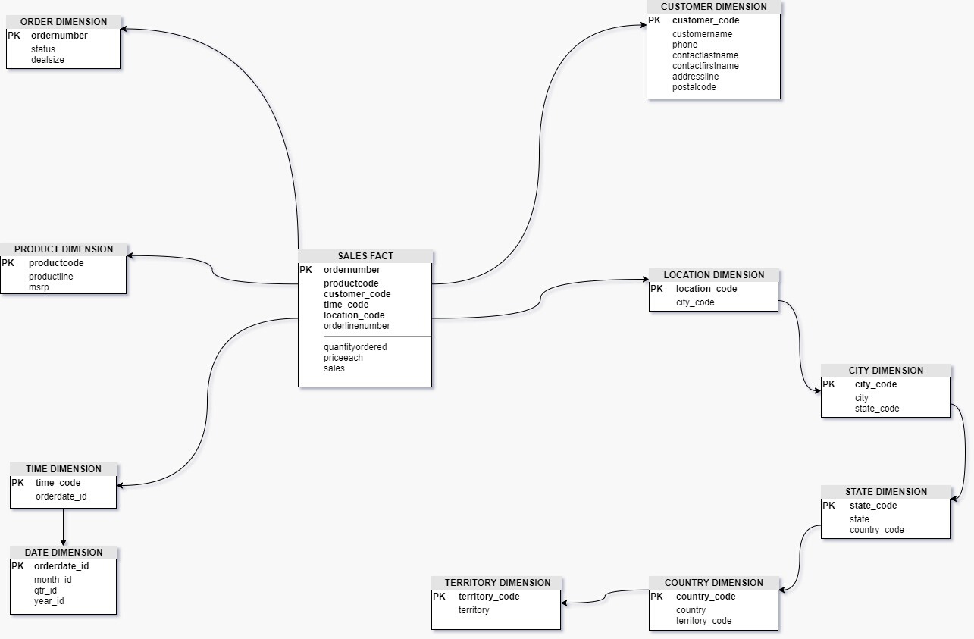
Case Study - Data Warehouse
Initial Snowflake Schema
/14

Slide 15
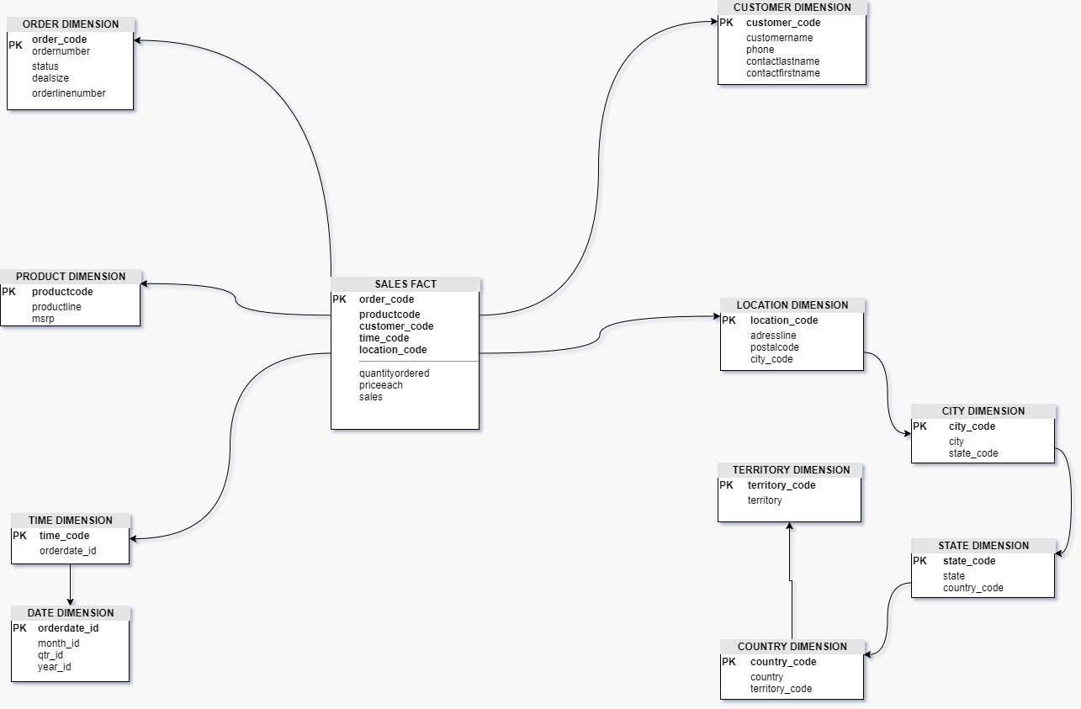
Case Study - Data Warehouse
Final
Snowflake Schema
/15

Slide 16
/16
Item 5
20%
Item 1
20%
Item 4
20%
Item 2
20%
Analytics
Case Study - Data Warehouse
Item 3
20%
Cognos Business Intelligence Tool

Slide 17
Web based Integrated BI tool
Explore the data and identify relationships
Analyze the trends using graphical representations
User friendly dashboards and reports
Data Visualization
Case Study - Data Warehouse
/17

Slide 18
Created a database using AWS Amazon RDS
Created a schema using MYSQL workbench
Established the database connection in Cognos BI
Data Module
Case Study - Data Warehouse
/18

Slide 19
/19
Item 5
20%
Item 1
20%
Item 4
20%
Item 2
20%
Reports
Case Study - Data Warehouse
Item 3
20%
Cognos Business Intelligence Tool

Slide 20
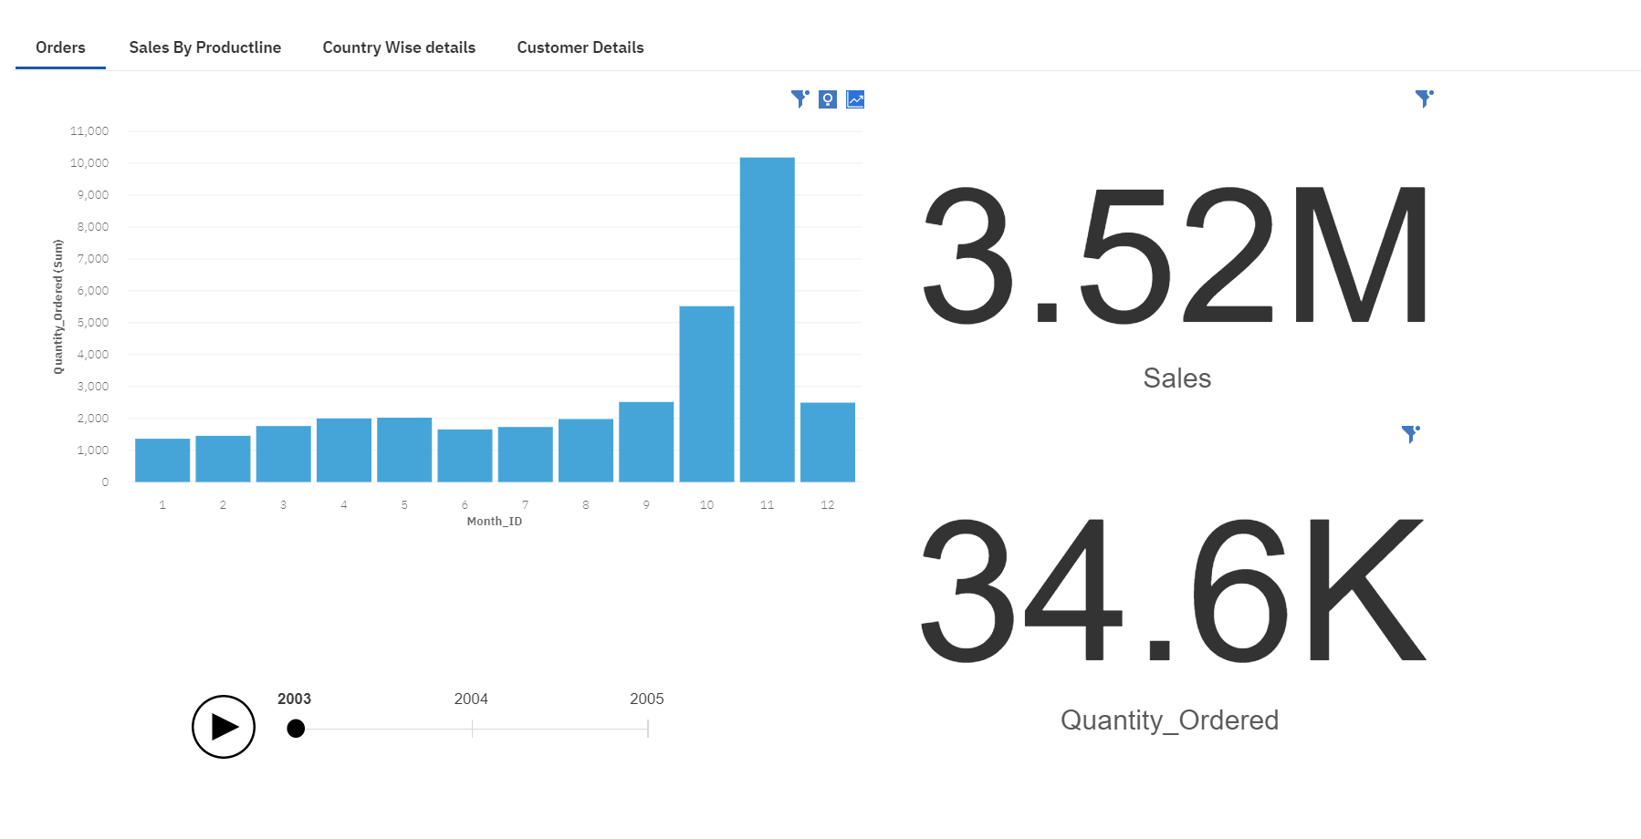
/Orders
Case Study - Data Warehouse
/20

Slide 21
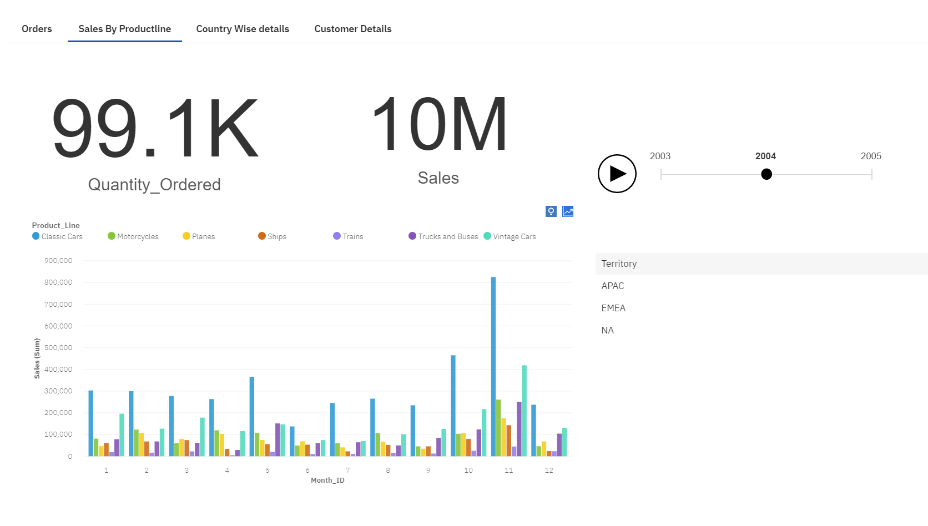
/Sales By productline
Case Study - Data Warehouse
/21

Slide 22
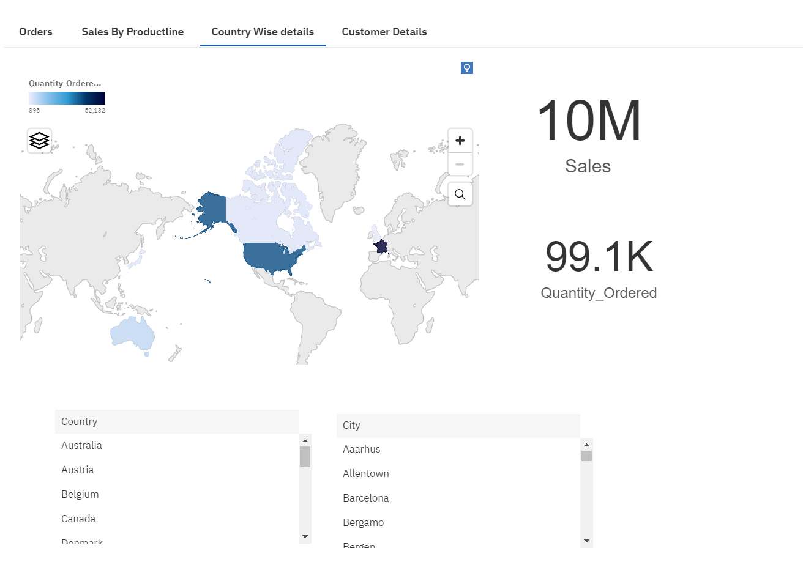
/Country wise details
Case Study - Data Warehouse
/22

Slide 23
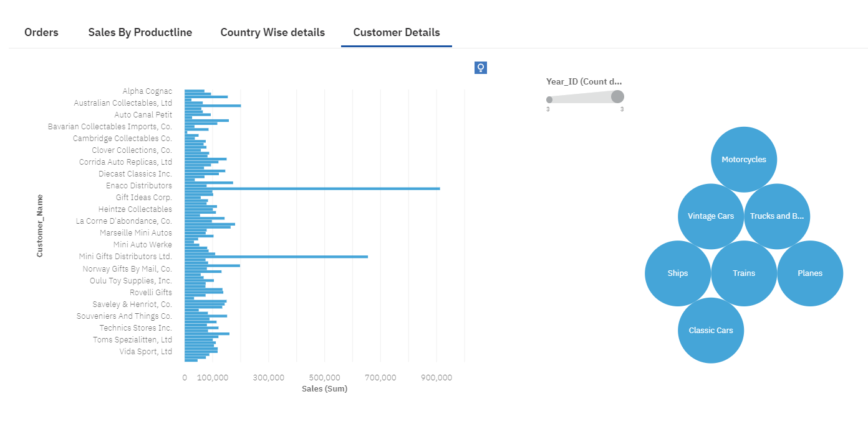
/Customer details
Case Study - Data Warehouse
/23

Slide 24

Case Study - Data Warehouse
Thank you!
/24

Slide 25
References
Case Study - Data Warehouse
Slide 1 - “Image,” Canva. [Online]. Available: https://media-public.canva.com/MADFC8y4jj8/1/thumbnail_large.jpg. [Accessed: 02-Apr-2020].
Slide 2 - “Building Snapshot,” Canva. [Online]. Available: https://media-public.canva.com/MADGyZka4gk/4/thumbnail_large.jpg. [Accessed: 02-Apr-2020].
Slide 3 - E. Lisowski, E. Lisowski, Edwin LisowskiExperienced Information Management Consultant, and Data Warehousing, “Data Warehouse Implementation [Step by Step Guide],” Addepto, 04-Oct-2019. [Online]. Available: https://addepto.com/implement-data-warehouse-business-intelligence/. [Accessed: 02-Apr-2020].
Slide 9 - “Extract, Transform, and Load,” bismart. [Online]. Available: https://blog.bismart.com/hubfs/Imported_Blog_Media/ETL/20190604_imagen2.jpg. [Accessed: 02-Apr-2020].
Slide 12, 14, 15 - “diagrams.net - free flowchart maker and diagrams online,” Flowchart Maker & Online Diagram Software. [Online]. Available: https://app.diagrams.net/. [Accessed: 03-Apr-2020].
"IBM Knowledge Center", Ibm.com, 2020. [Online]. Available: https://www.ibm.com/support/knowledgecenter/SSEP7J_11.1.0/com.ibm.swg.ba.cognos.cbi.doc/welcome.html. [Accessed: 02- Apr- 2020].
/25

